Slide 1
Understanding UMAP The Internal Workings of a State-of-the-Art Clustering Algorithm
Abhishek Deshpande
Maharashtra Institute of Technology, World Peace University, Pune
Soham Joshi
Vishwakarma Institute of Technology, Pune
Varad Deshmukh
University of Colorado Boulder
Shrirang Karandikar
AlgoAsylum

Slide 2
Uniform Manifold Approximation and Projection
Topological Data Analysis and Manifold Learning
Used For
Dimensionality Reduction
Unsupervised Clustering
Supervised Dimension Reduction and Metric Learning
Riemannian geometry inspired TDA
Well-defined, easy-to-use black box
RELAX!
This is not a mathematical intervention!
The rest of this talk will describe how UMAP works, and how to select parameters for the best outcomes
Notes:
The rest of this talk will describe how UMAP works, and how to select parameters for the best outcomes

Slide 3
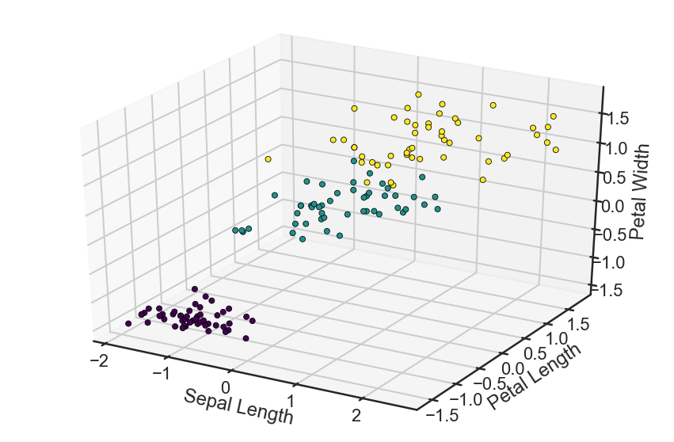
Iris dataset
3 Clusters (Species of Flowers)
4 dimensions
150 data-points

Slide 4
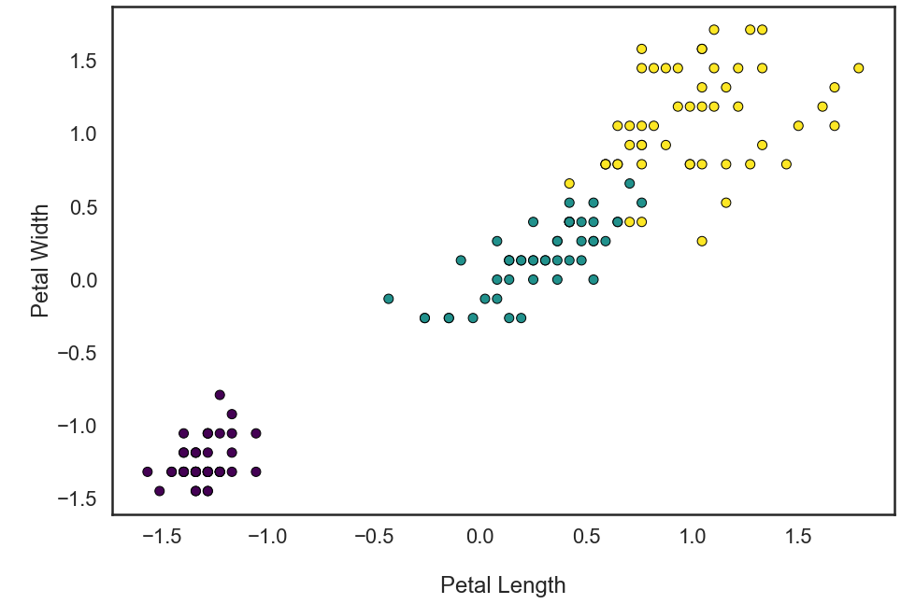
Iris Dataset Projection
Consider 2-D data visualization for simplicity

Slide 5
UMAP steps
Fuzzy Simplicial Sets:
Identify neighbors and relations
Simplicial Complexes:
Select correct neighbors
Generate Graph
Create Adjacency Matrix
Force Directed Layout
Adjust weights for relative positions of local coordinates
Final Output
Create embedding with reduced dimensionality
Notes:
Fuzzy Simplicial Sets: Form open balls with radius one (locally varying metric)
Simplicial Complexes: Fuzzy union or probabilistic merging of disagreeing weights
Generate Graph:
All simplicial complexes with combined weights form a single graph
Force- directed layout:
Get the data to be in the standard euclidean distance with respect to the global coordinate system. Using min_dist

Slide 6
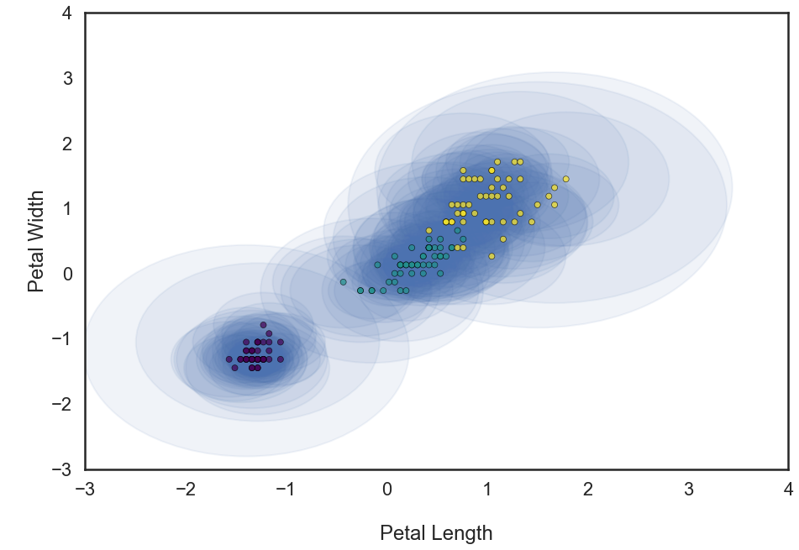
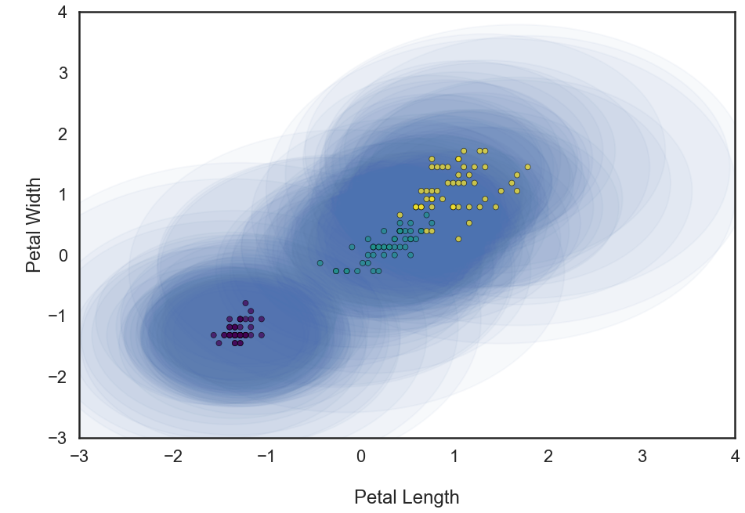
Step 1: Fuzzy Simplicial Sets
N_neighbors = 5
N_neighbors = 30

Slide 7
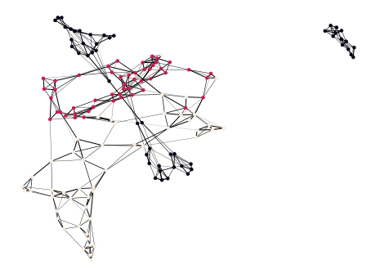
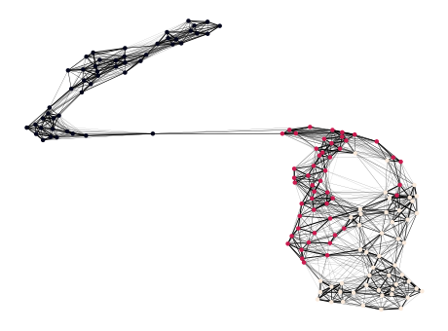
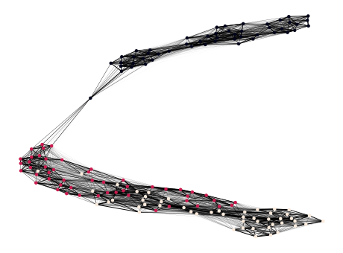
Step 3: Simplicial graphs
N_neighbors = 5
N_neighbors = 15
N_neighbors = 30

Slide 8
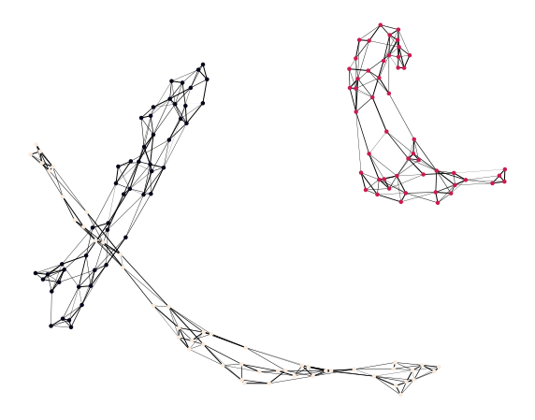
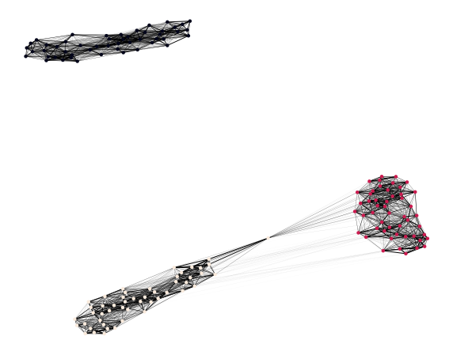
Step 4: Force directed graphs
N_neighbors = 5
N_neighbors = 30

Slide 9
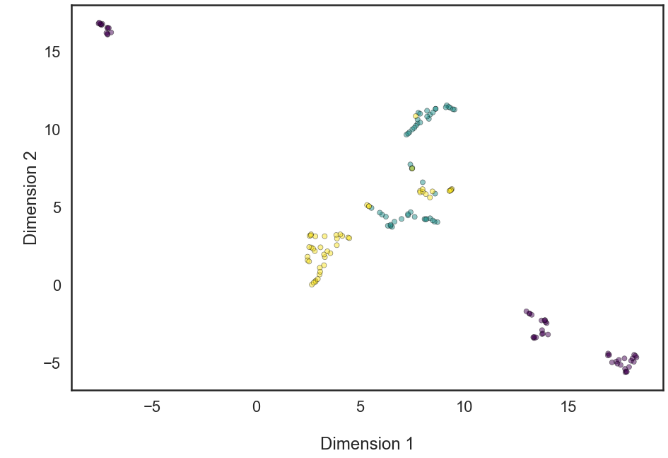
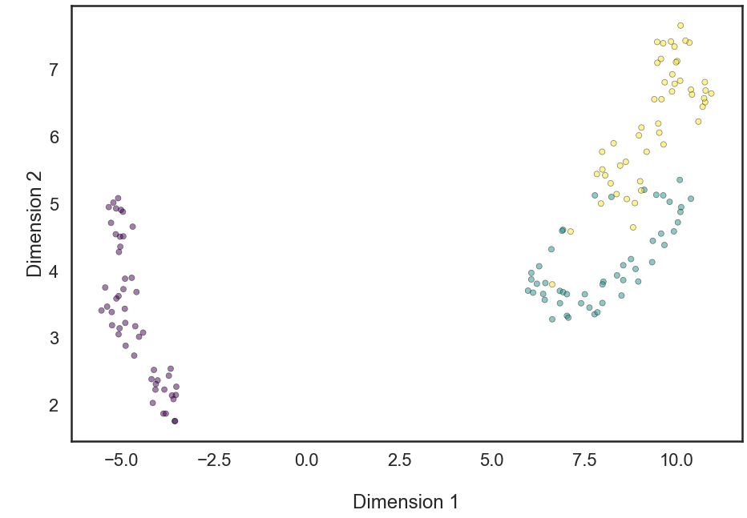
Step 5: Final output
N_neighbors = 5
N_neighbors = 30

Slide 10
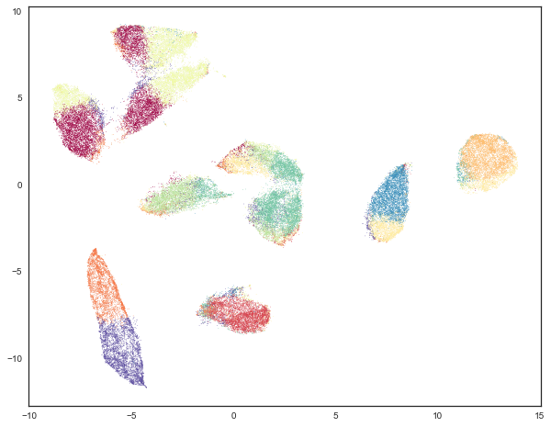
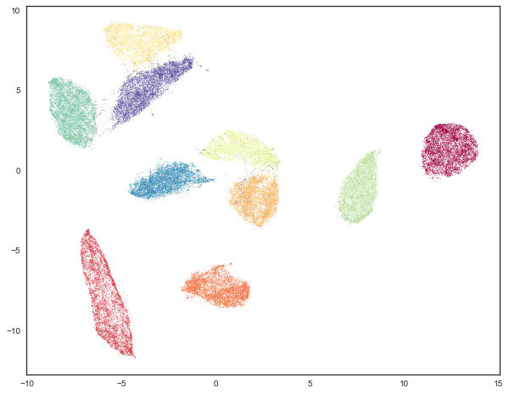
Higher Dimensional Data
K-Means Clustering
UMAP

Slide 11
Summary
UMAP is a powerful algorithm based on advanced mathematics
Black Box
Trial & Error
Hit & Miss
Understand the internals, the steps and the parameters
Efficient usage and better results

